Slide 1




Introduction To Programming
Data storage and operations
SoftUni Team
Technical Trainers
Software University
http://softuni.bg

Slide 2

Table Of Contents
How do we store data?
Variables and constants
Declaration and initialization
Datatypes
How can we manipulate the data?
Operators
Operator Precedence

Slide 3

Data Storage

Slide 4
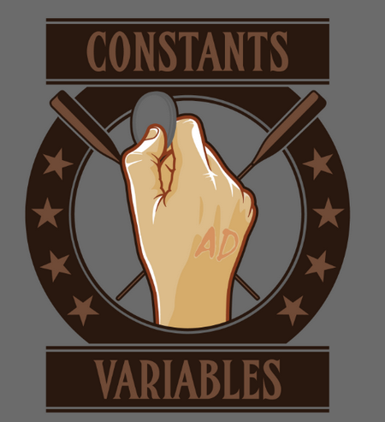
Variables and Constants
Variables are placeholders which provide temporary storage for values during the execution of the program
Constants are data fields or local variables whose values cannot be modified

Slide 5


Variables and Constants
Variable
int number = 10;
number = 20;
const float PI = 3.14f;
PI = 54.2f;
Constant
Variables can be initialized later than their declaration and their values can be changed
Constants must be initialized with their very declaration and their values cannot change

Slide 6


Naming Rules
A variable name must begin with a letter or an underscore
can contain only letters, numbers, or underscores
must not exceed 255 characters
must be uniquely named within the scope in which it is defined
int 1number = 1;
int num!beer = 2;
int number = 3;
int number = 4;
int digitThree = 3;
int _numberFour = 4;

Slide 7
Declaration and Initialization
Declaration
int number;
number = 20;
int secondNumber = 20;
Initialization
Declaration and initialization
The initialization is not necessarily on the same line as the declaration of a variable
The initialization value MUST be of the same type as the declaration

Slide 8
Datatypes
Data Type | Size | Range of values
byte | 1 byte ( 8 bits ) | 0 to 255
char | 2 bytes ( 16 bits ) | U + 0000 to U + ffff (Unicode)
short | 2 bytes ( 16 bits ) | -32, 768 to 32, 767
int | 4 bytes ( 32 bits ) | -2, 147, 483, 648 to 2, 147, 483, 647
long | 8 bytes ( 64 bits ) | -9, 223, 372, 036, 854, 775, 808 to 9, 223, 372, 036, 854, 775, 807
float | 4 bytes ( 32 bits ) | -3.4 × 10³⁸ to 3.4 × 10³⁸
double | 8 bytes ( 64 bits ) | ±5.0 × 10⁻³²⁴ to ±1.7 × 10³⁰⁸
bool | 1 bytes ( 8 bits ) | True or False

Slide 9
Arrays
An array is a collection of items, with identical type
each item can be accessed by using a unique index
Declaration and initialization of array
int[] array = new int[5];
Console.WriteLine(array[2]);
array[2] = 1;
Accessing an element by it’s index
Setting value to an element

Slide 10
Operators

Slide 11
Operators
Operators are symbols that specify which operation to perform on the operands before returning a result
Examples of operators include +, -, *, /, and so on
Operands can be variables, constants, literals, etc.
Depending on how many operands are involved, there are three kinds of operators:
Unary operators – the unary operators work with only one operand
Binary operators – the unary operators take two operands
Ternary operators – the unary operators take three operands

Slide 12
Operators
Category | Operators
Primary | x.y, f(x), a[x], x++, x--, new, typeof
Unary | +, -, !, ~, ++x, --x, (T)x
Multiplicative | *, /, %
Additive | +, -
Shift | <<, >>
Relational and type testing | <, >, <=, >=, is, as
Equality | == !=

Slide 13
Operators
Category | Operators
Logical AND | &
Logical XOR | ^
Logical OR | |
Conditional AND | &&
Conditional OR | ||
Conditional Ternary | ?:
Assignment | == *= /= %= += -= <<= >>= &= ^= |=

Slide 14

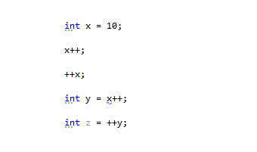
Operators
Live Demo

Slide 15

Summary
How do we store values in our program?
What are variables and constants?
How to declare and initialize variables?
How to correctly name variables?
How to manipulate the values of variables?
What are arrays?
What are operators?

Slide 16








Questions
https://softuni.bg/courses/javascript-applications/

